Slide 1
Next Stop: Full Accessibility
Next Stop: Full Accessibility
Litigating Access to the Country’s Most Popular and Least Accessible Subway System
By: Emily Seelenfreund and Rebecca Serbin
Disability Rights Advocates

Slide 2
The Lifeblood of the City
Owned by NYC who leases it to the New York City Transit Authority (“NYCT”), a subsidiary agency of the state-run Metropolitan Transportation Authority (“MTA”)
In 2017 the MTA provided trips for eight million daily subway riders totaling up to 2.5 billion annual trips in a 24/7 System.
NYC is the only city in the United States where over half (55%) of all households do not own a car: 39% of commuters travel to work daily via subway
As former MTA Chairman Thomas Prendergast noted “New Yorkers and visitors alike continue to vote with their feet, recognizing that riding the subway is the most efficient way to get around town.”

Slide 3
Access Denied: Popularity Doesn’t Equal Accessibility
75% of the MTA’s 472 subway stations (360) are entirely off-limits to passengers who cannot take stairs to access the subway. The NYC Subway is the least accessible rapid transit system in the nation- by a wide margin.
The distance between accessible stations can exceeds 30 blocks and several miles on some subway lines with gaps of 10 or more stations between accessible stops.
Of the 122 New York City neighborhoods that are served by the subway system, 62 do not have a single accessible subway stop. Of those 62 neighborhoods that are inaccessible by subway, 55 are in the Bronx, Brooklyn, and Queens.

Slide 4
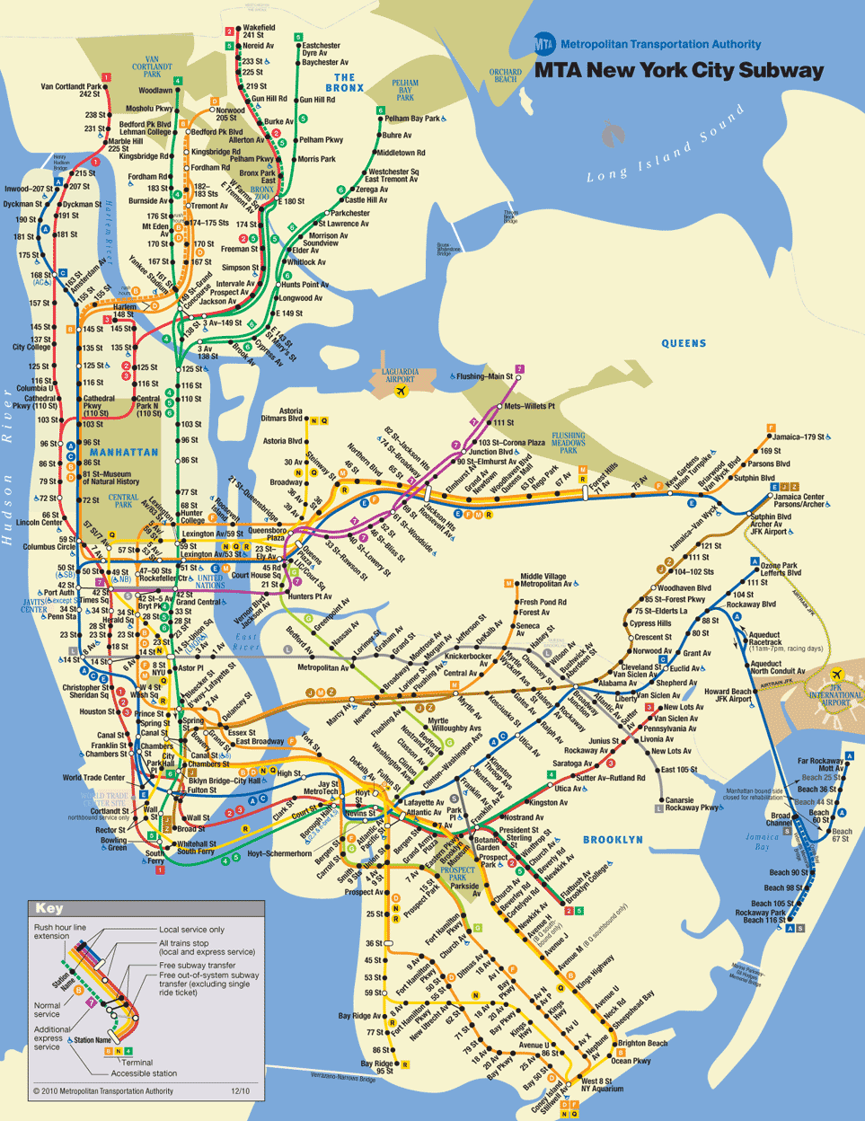
The New York City Subway System versus the New York Subway System’s Accessible Stations
VS

Slide 5
Wayfinding Error: How did we get Here?
NYC Mayor Ed Koch in 1983: "I have concluded that it is simply wrong to spend $50 million in the next eight years—and ultimately more—in putting elevators in the subways.”
Disabled in Action and the EPVA brought a Section 504 lawsuit resulting in a 1984 settlement- created the NYC Paratransit program, required buses to be wheelchair accessible, and required accessibility at 65 “key” subway stations within 6 years
The ADA codified the “key stations” concept- requiring retrofitting of certain stations for existing “fixed rail” public transportation systems – rather than full accessibility. NYC requirements were expanded from 65 key stations to 100 and the timeline was increased to 2020.

Slide 6
The ADA Continued
Alterations rule: When a public entity “alters an existing facility . . . in a way that affects or could affect the usability of the facility or part of the facility, the entity shall make the alterations . . . in such a manner, and to the maximum extent feasible, that the altered portions of the facility are readily accessible to and usable by individuals with disabilities, including individuals who use wheelchairs.” 42 U.S.C. § 12147(a).
Maintenance of Accessible Features: Under the ADA, public entities like the MTA are also required to ensure that the limited elevators that do exist are adequately maintained. “Entities providing transportation services must maintain “those features of facilities . . . that are required to make . . . facilities readily accessible” in “operative condition.” 49 C.F.R. § 37.161(a)
Notes:
Aimed at the ADA’s overreaching purpose of progressive accessibility.
The MTA has by and large ignored this provision and/or taken an extremely narrow internal interpretation of it. Instead-they have done the bare minimum- focusing on key stations with little consideration for access beyond that for most of the last 30 years.

Slide 7
ADA Requirements
A public entity must:
Make key stations accessible
Make stations accessible when the public entity chooses to renovate stations (degree of obligation varies with scope of renovation)
Maintain the accessible features already in the system (elevators, escalators)
But what if a station isn’t accessible (nothing to maintain), hasn’t been renovated, and isn’t a key station?

Slide 8
New York City Human Rights Law: Another Legal Hook
N.Y.C. Admin. Code § 8-107(4)(a), states“[i]t shall be an unlawful discriminatory practice for any person, being the owner, lessee, proprietor, manager, superintendent, agent or employee of any place or provider of public accommodation because of the actual or perceived . . . disability . . . status of any person directly or indirectly, to refuse, withhold from or deny to such person any of the accommodations, advantages, facilities or privileges thereof . . .”

Slide 9
Bronx Independent Living Services(“BILS”) v. MTA
Filed in 2016
This case challenge the MTA’s failure to make one particular station in the Bronx accessible after completing a major renovation that included replacing every staircase at that station (violation of alterations rule).
Building on FTA circular, SEPTA case in Philadelphia
March 2019 partial summary judgment on liability (that the replacement of the stairs at Middletown road triggered the obligation to make the station accessible unless it was technically infeasible to do so).
Current battle: technical feasibility

Slide 10
Forsee v. MTA
Filed in May 2019: case builds on our successful ruling in BILS v. MTA and challenges the MTA’s pattern of closing stations for months at a time and conducting major renovations without considering stair-free access (violations of alteration rule). Our BILS Judge accepted this as a related case.
Defendants filed a successful 12(c) motion for judgment on the pleadings- on the basis that our claims are time barred with respect to all stations renovated prior to the three year statute of limitations period.
Plaintiffs now proceeding with discovery based on a shortlist of “exemplar” stations”

Slide 11
Center for Independence of the Disabled New York (“CIDNY”) v. MTA
In April 2017 DRA, on behalf of six disability rights organizations and three wheelchair users, filed dual lawsuits against the MTA.
The first lawsuit- brought in federal court- and therefore referred to as “CIDNY federal” challenges the MTA’s systemic failure to maintain the limited number of elevators that do exist in the subway system (violation of ADA requirement to maintain accessible features).
The second lawsuit- “CIDNY state” alleges that the MTA discriminates against plaintiffs and the putative class by operating a system that is less than 25% accessible (violation of NYC Human Rights Law).

Slide 12
Federal Lawsuit- Elevator Maintenance
NYC Subway elevators are unavailable 3.5% of the time.
~4 elevators needed to complete a one-way trip.
Almost no redundant elevators in the system.
80% of outages a result of unplanned breakdowns as opposed to planned maintenance
Litigation Hurdle: demonstrating the real-world impact of the above necessitated a hotly contested, year-long expert discovery phase of litigation involving eight experts.
One expert concluded that a typical daily commuter reliant on elevators would experience a failed trip 8-15% of the time.
MTA countered with contorted statistics involving median trip availability and “alternative routes.”
In April 2020 the District Court denied Plaintiffs’ motion for summary judgment and granted the MTA’s, holding that Plaintiffs had not established a denial of meaningful access to the subway system.
Plainitffs appealed this decision to the Second Circuit- that argument is fully briefed along with three amicus curiae in support, and we are waiting for an oral argument date.

Slide 13
State Lawsuit- Global Subways Case
Defendants filed motions to dismiss our case on four grounds: 1) preemption, 2) justiciability, 3) statute of limitations, and 4) lack of control
Following a year of unsuccessful settlement talks- Judge Hagler denied Defendants’ motions on all fronts, stating “there is no license by the MTA, by any other agency to discriminate against any individual by race, minority, ethnicity or disability.”
The MTA subsequently fired its in-house team and hired a private law firm. On June 8, 2020 a unanimous appellate court affirmed the lower court’s ruling on the Motion to Dismiss
On February 21, 2021 the case was certified as a class action

Slide 14
FOIL Request Turned Article 78 Petition
Station-wide accessibility survey
NY Freedom of Information Law
State court proceeding (Article 78) to challenge the MTA’s constructive denial of our FOIL petition seeking access to the survey
Settled in January 2020

Slide 15
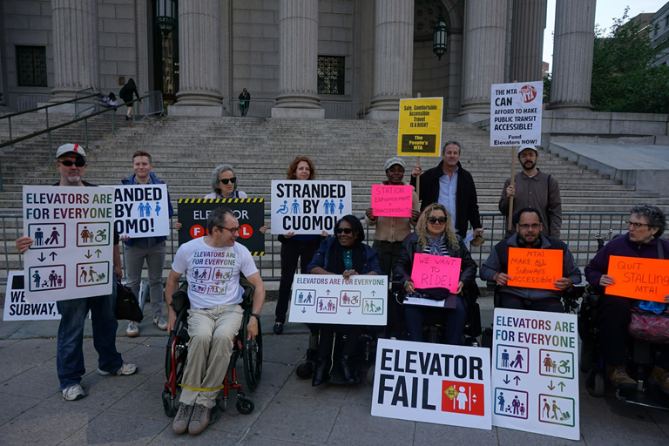
Factors for Success
Community Activism
Growing Media and Public Awareness
Political Support

Slide 16
Challenge: Covid-19
Subway Ridership down drastically – over 70%
MTA predicts “new normal” ridership that stabilizes in 2023 and 2024 between 80% and 92% of pre-pandemic levels.
MTA facing $8 Billion Deficit Through 2024
MTA initially moved forward with scheduled accessibility projects, but promise of 50 stations in 2020-2025 Capital Plan and 130 in 2025-2029 are in jeopardy

